Slide 1

Switching pages like Houdini
Advanced Coding Course – Week 4

Slide 2

How do I go from one page to another in a single page app?
Objective
By the end of this lesson you will understand how to make a single page app navigates from one screen to another.
vuejs routers

Slide 3
Agenda
Review Single Page App Principles
What are Vue JS Routers
Exercise
Questions
Assignment
vuejs routers

Slide 4
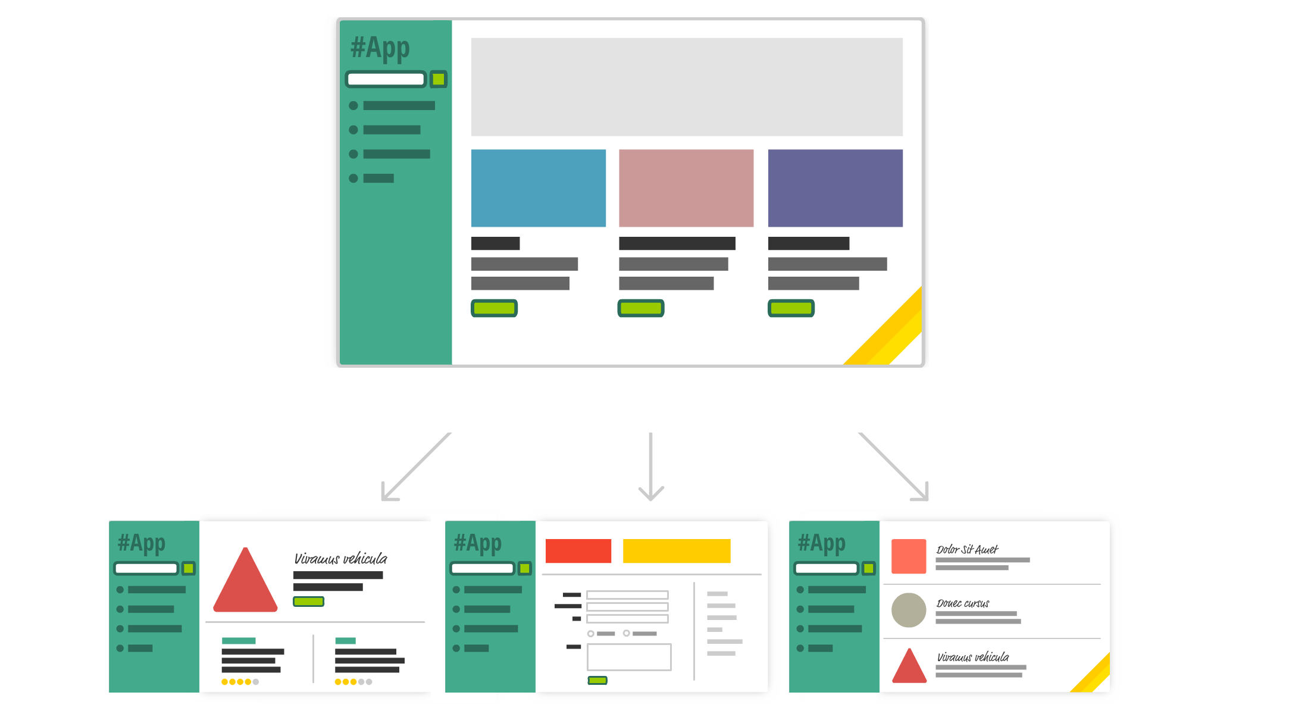
VueJS Single Page App Principles
Normal Website Behavior
Click a link and navigate to a whole new web page and update the URL
Single Page App behavior
Click a link and replace the current visuals with new content
vuejs routers

Slide 5
Vue JS Routers
In a JavaScript web application, a router is the part that syncs the currently displayed view with the browser address bar content.
Routers are stored in a separate file that imports the vue files and then defines them for global use
vuejs routers

Slide 6
Router Exercise – Part 1
Follow These Steps
Open Terminal on your computer
In Terminal enter cd Desktop
In Terminal enter vue create routerproject
Select Manually select features
Select Router from the menu with the spacebar and press Enter
Select no for history mode
Choose the default settings that are already selected
After the project is done being created enter the command cd RouterExercise
In Terminal enter npm run serve and open a browser and go to http://localhost:8080/
vuejs routers

Slide 7
Router Exercise – Part 2
Follow These Steps
Create a new file in the views folder called Contact.vue
In Contact.vue enter
<template>
<div class=”contact”>
</div>
</template>
<script>
export default {
name: ‘contact',
components: {}
}
</script>
Enter your Name, Email and Phone Number inside the contact div
vuejs routers

Slide 8
Router Exercise – Part 2 (continued)
Follow These Steps
Open router/index.js
Add import Contact from '../views/Contact.vue’
Add below to the routes array:
{
path: ‘/contact',
name: ‘contact',
component: Contact
}
vuejs routers

Slide 9
Conclusion
Objective
By the end of this lesson you will understand how to make a single page app navigates from one screen to another.
vuejs routers

Slide 10

questions

Slide 11
Assignment
Final Objective
Create a new view called Favorites with a heading and add lists of your favorite songs and movies. Then add it to the navigation. All text and favorites should be driven by the data object in your vue file.
Resources
https://vuejs.org/v2/guide/list.html
what is vuejs

